Slide 1

By Nitin Chaudhary (9921103163)
Introduction to Contemporary Research and Term Paper Writing Presentation
Title:
Fine Tuning of Bidirectional Encoder Representations from Transformers for Optimizing News Classification
Supervisor:
Dr. Himanshu Agarawal (Associate Professor )
Department of Computer Science & Engineering and Information Technology Jaypee Institute of Information Technology, Noida

Slide 2
Objective: The objective of this presentation is to provide a comprehensive understanding of fine-tuning of pre-trained Bidirectional Encoder Representations from Transformers (BERT) model for classifying news [5].
This presentation aims to:
Highlight the need for news text classification.
Explain the selection and advantages of BERT for text classification.
Discuss the key features and Machine Learning life cycle steps.
Fine tuning of BERT.

Slide 3
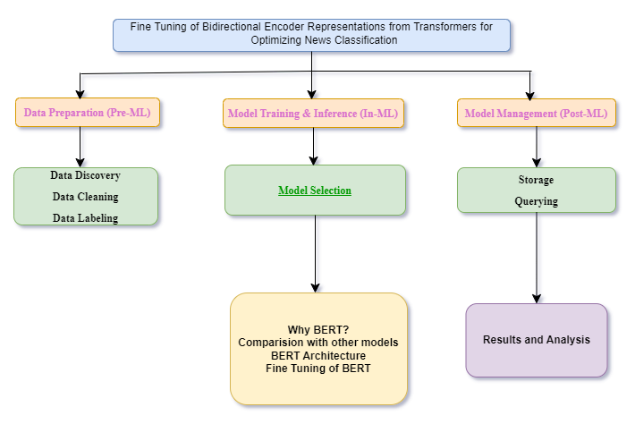
Flow of presentation:

Slide 4
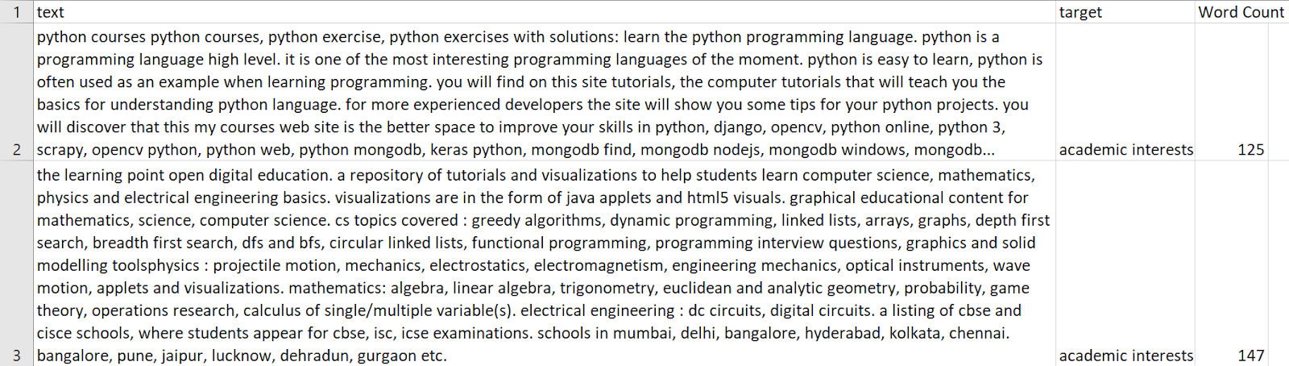
Data Preprocessing before Applying Machine Learning
Data Discovery: The dataset is of size 823.354 MB in Excel format and contains 3 columns text, target label and word count. There are total 26 classes in target label. This dataset is cleaned before using for training BERT [1].

Slide 5
Classes in Dataset:
There are total of 26 classes in the dataset which includes-
academic interests
arts and culture
automotives
books and literature
business and finance
careers
family and relationships
food and drinks
health
healthy living
hobbies and interests
home and garden
movies
music and audio
news and politics
personal finance
pets
pharmaceuticals, conditions, and symptoms
real estate
shopping
sports
style and fashion
technology and computing
television
travel
video gaming

Slide 6
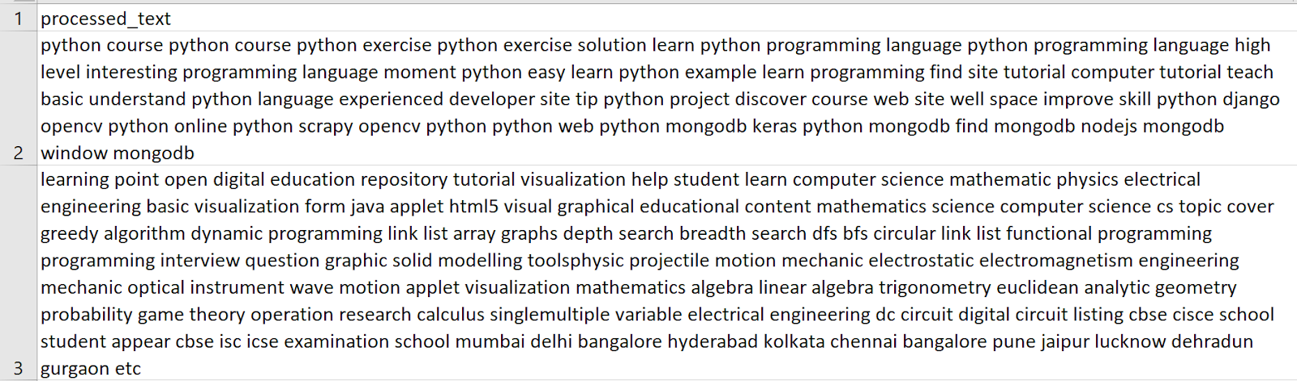
Data Cleaning
The data cleaning involves removing URLs, special characters, and unnecessary white spaces from text [2].

Slide 7
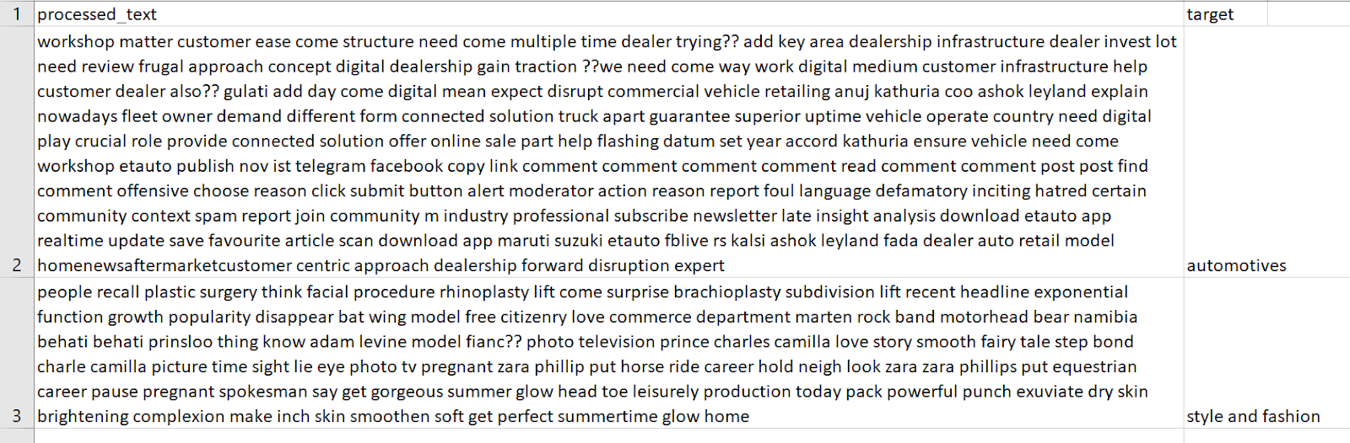
Data Labeling
Every processed text sample has been assigned to one of 26 categories. Good labeling is important for ensuring the BERT model to learn patterns and relationships in the data [1].

Slide 8
Model Selection:
For classification of news articles into 26 categories, BERT is chosen.
Comparison of BERT with 5 other models:
Features | BERT | SVM | Naive Bayes | LSTM | CNN | RNN
Contextual Understanding | Excellent (Bidirectional) | Poor | Poor | Good (Unidirectional) | Moderate | Good (Unidirectional)
Pre-training | Yes | No | No | No | No | No
Fine-tuning | Yes | No | No | Yes | Yes | Yes
Handling Long Dependencies | Excellent | Poor | Poor | Good | Poor | Moderate
Performance on NLP Tasks | Excellent (State-of-the-art) | Moderate | Moderate | Good | Good | Good

Slide 9
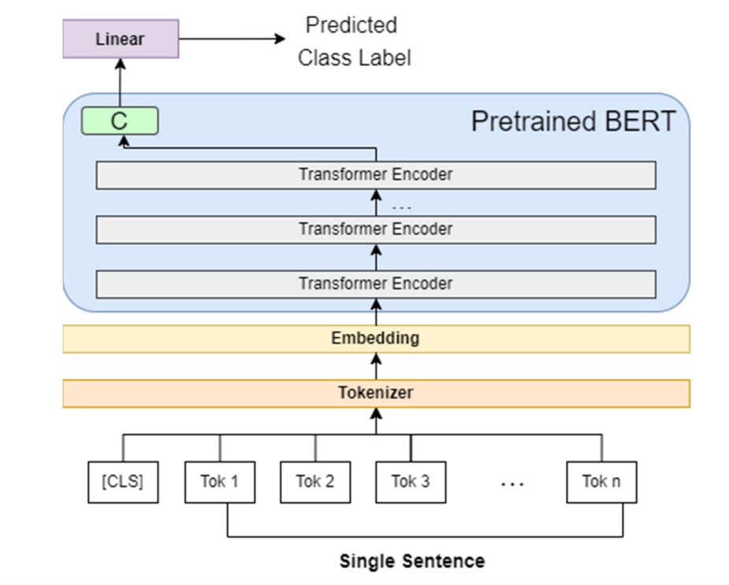
BERT Architecture

Slide 10
Parameters of the BERT for fine tuning: Here are the key parameters used during the fine-tuning of BERT for news classification:
1. Learning Rate (lr)
Value: 2e-5, A lower learning rate was chosen to fine-tune the pretrained BERT model without significantly disrupting its weights, ensuring stable updates during training.
2. Batch Size
Value: 16, A batch size of 16 strikes a balance between memory usage and training stability. Larger batches would require more memory, while smaller batches might slow down convergence.
3. Epochs
Value: 3, Since BERT is already pretrained, only 3 epochs were needed for fine-tuning. This is sufficient to adapt the model to the specific task without overfitting.
4. Warm-up Steps
Value: 500, Warm-up steps help stabilize the early stages of training by gradually increasing the learning rate, avoiding large updates that might destabilize the model.

Slide 11
Storage
The fine-tuned BERT model is saved in the SafeTensors format to store and load efficiently.
Querying
After the storage step, both Model and the Tokenizer get loaded to process the new data through texts and make appropriate predictions for the user queries.
LIVE DEMO OF QUERYING TO FINE TUNED BERT MODEL

Slide 12
Sample Example:
Case 1: Correct output
{
"text": "strongly believe auto sector actually well auto auto ancillary service domestic market actually global playswe believe activity pick industrial logistic player benefit say sachin shah fund manager emkay investment research couple weekswe look overall rebound economy perspective place see lot buoyancy hiring start service spread business business leader bent hire lower attrition rate advt india inc hire spree certain domestic outsourcing company hiring focussed believe activity pick industrial logistic player benefit ecommerce good thing industrial movement good twothree year particularly calendar year couple quarter see green shoot interesting logistic play point time avoid underperforming area market auto sector case build position select basis therewe strongly believe auto sector actually well auto auto ancillary service domestic market actually global play basically world market revenue come export marketsthey decent presence domestic market domestic market underpenetrate term personal mobility rise capita income create demand secular story go cyclical blip auto sector definitely go months?? perspective advt case banking financial service see smart recovery base overall economic activity banking backbone economy believe go well credit asset quality well credit growth interest rate low banking service tend benefit spread alsoalso read auto sector play big role make india usd tn economy???? government focused development electric mobility project work undertake automotive research association india arai establish component system electric vehicle evs big step future",
"true_category": "automotives",
"predicted_category": "automotives",
"predicted_probability": 0.9913038015365601,
"true_category_probability": 0.9913038015365601
}

Slide 13
Case 2: Wrong Output
{
"text": "chandigarhmohalipanchkula time cricket big extravagnza icc world cup go saturday television screen city game cable operator siti win fastway involve tussle official telecaster espn star sports ess hike subscription charge effort break deadlock work outthe matter take monday dispute come hear punjab haryana high court cable network allege ess strongarm tactic stop service seek large sum number household get tv signal sport channel say start provide service till happenedthe match telecast national broadcaster doordarshan dd miss expert commentary available satellite channel dd not come rescue cricket lover time right india game semifinal final air highlight remain matchessector18 resident rohit sood say look forward watch indiabangladesh match espn english commentary force watch game dd1 speak cable operator promise match startedamrik shergill resident phase vi mohali say friend decide gettogether house watch match party plan go waste ess channel black outresident sector panchkula jimmy gupta say decide pm watch match pub match show dd enjoy commentary sunil gavaskar ravi shastri miss",
"true_category": "sports",
"predicted_category": "television",
"predicted_probability": 0.43149179220199585,
"true_category_probability": 0.31475645303726196
}

Slide 14
RESULTS AND ANALYSIS Performance Results
Samples Per Category | Precision | Accuracy | Recall | F1-Score
10 | 0.7781 | 0.7712 | 0.7711 | 0.7715
50 | 0.8282 | 0.8261 | 0.8262 | 0.8243
100 | 0.8180 | 0.8161 | 0.8162 | 0.8160

Slide 15
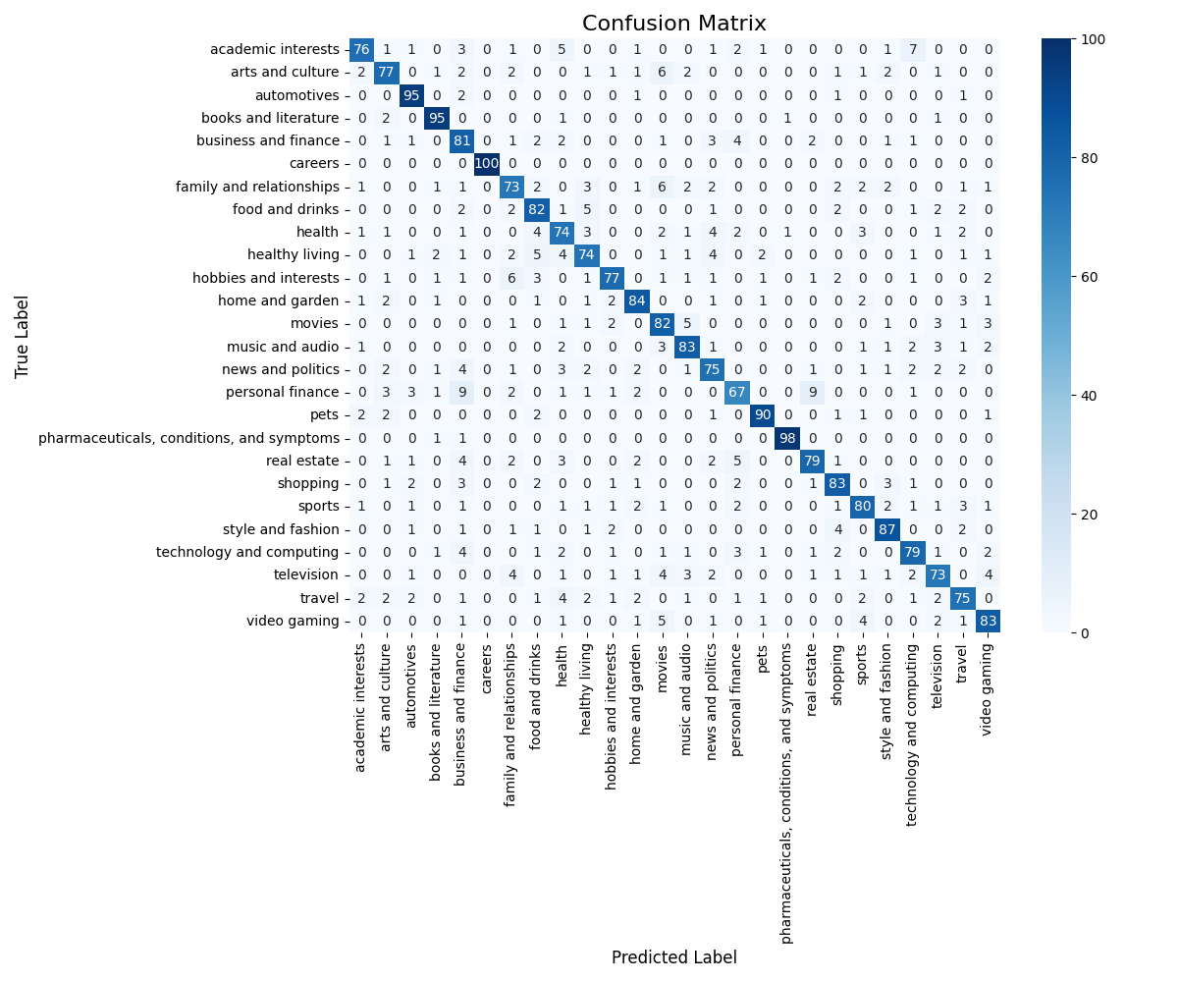
Confusion Matrix

Slide 16
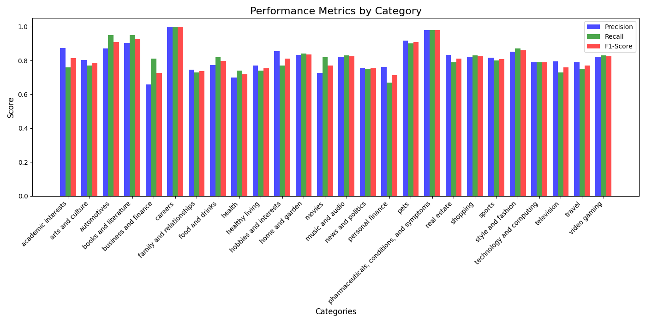
Performance Chart by Category

Slide 17
CONCLUSION
Bidirectional Encoder Representations from Transformers (BERT) model [9] is used in this report to classify news articles into 26 predefined categories. In this, we fine-tuned a pretrained BERT model on a curated news dataset to leverage its deep language understanding for achieving high accuracy in the task of text classification.
Key takeaways are:
Data Preprocessing: A good quality training dataset requires the process of data discovery, cleaning, and labeling.
Model Training: Feature selection, model selection, and speeding up the training of a model make the entire training process efficient and effective.
Model Selection: Since BERT can extract contextual relations in text, it is mostly suited for text classification when fine-tuned to a specific dataset.
Parameter Tuning: It is important that how well the training parameters are selected. Few important parameters are the learning rate, the batch size, and also the number of epochs [10].

Slide 18
Performance: The BERT model actually scores very high with very precise, recall, and F1-score.
Improvements: Techniques with the inclusion of more data or even higher architectures for the models such as RoBERTA or DistilBERT [7] can be considered for potential future work.

Slide 19
References:
[1] C. Chai, J. Wang, Y. Luo, Z. Niu, and G. Li, “Data Management for Machine Learning: A Survey,” IEEE Transactions on Knowledge and Data Engineering. Institute of Electrical and Electronics Engineers (IEEE), pp. 1–1, 2022. doi: 10.1109/tkde.2022.3148237.
[2] F. Hohman, M. B. Kery, D. Ren, and D. Moritz, “Model Compression in Practice: Lessons Learned from Practitioners Creating On-device Machine Learning Experiences,” Proceedings of the CHI Conference on Human Factors in Computing Systems, vol. 22. ACM, pp. 1–18, May 11, 2024. doi: 10.1145/3613904.3642109.
[3] A. Kumar, M. Boehm, and J. Yang, “Data Management in Machine Learning,” Proceedings of the 2017 ACM International Conference on Management of Data. ACM, May 09, 2017. doi: 10.1145/3035918.3054775.
[4] https://link.springer.com/book/9780387310732 [Christopher M. Bishop Pattern Recognition and Machine Learning]
[5] C. Sun, X. Qiu, Y. Xu, and X. Huang, “How to fine-tune bert for text classification?,” Lecture Notes in Computer Science, pp. 194–206, 2019. doi:10.1007/978-3-030-32381-3_16
[6] K. Nemkul, “Use of bidirectional encoder representations from Transformers (Bert) and robustly optimized Bert pretraining approach (Roberta) for Nepali News Classification,” Tribhuvan University Journal, vol. 39, no. 1, pp. 124–137, Jun. 2024. doi:10.3126/tuj.v39i1.66679
[7] Y. Arslan et al., “A comparison of pre-trained language models for multi-class text classification in the financial domain,” Companion Proceedings of the Web Conference 2021, pp. 260–268, Apr. 2021. doi:10.1145/3442442.3451375

Slide 20
[8] H. M. Zahera, I. A. Elgendy, R. Jalota, and M. Ahmed Sherif, Fine-tuned BERT model for multi-label tweets classification, 2019. doi:10.6028/nist.sp.1250.incident-dice_upb
[9] J. Devlin, M. Chang, K. Lee, and K. Toutanova, "BERT: Pre-training of Deep Bidirectional Transformers for Language Understanding," arXiv preprint arXiv:1810.04805, 2018. [Online]. Available: https://arxiv.org/abs/1810.04805.
[10] T. Wolf et al., "Transformers: State-of-the-Art Natural Language Processing," in Proceedings of the 2020 Conference on Empirical Methods in Natural Language Processing: System Demonstrations, 2020, pp. 38–45. [Online]. Available: https://huggingface.co/transformers.
[11] S. Islam et al., “A comprehensive survey on applications of Transformers for deep learning tasks,” Expert Systems with Applications, vol. 241, p. 122666, May 2024. doi:10.1016/j.eswa.2023.122666
[12] E. Azeraf, E. Monfrini, and W. Pieczynski, “Improving usual naive Bayes classifier performances with neural naive Bayes based models,” Proceedings of the 11th International Conference on Pattern Recognition Applications and Methods, pp. 315–322, 2022. doi:10.5220/0010890400003122
[13] C. Silva and B. Ribeiro, “Enhancing svms for text classification,” Studies in Computational Intelligence, pp. 51–70, 2010. doi:10.1007/978-3-642-04533-2_3
[14] “Automatic Text Classification Model based on machine learning,” Machine Learning Theory and Practice, vol. 4, no. 1, Mar. 2023. doi:10.38007/ml.2023.040106

Slide 21
Thank you

